Slide 1



PAYVICE
AVANTUS
Experience a world where agility simplifies payment

Slide 2


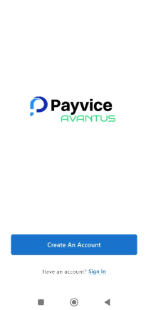
What is Payvice Avantus?
Payvice Avantus is an agency banking application designed for bills payment, cash in cash out and other value added services (VAS).
Payvice solution provide a variety of services and allow usage on Mobile Application, POS and integration on other third party platform.
PAYVICE create a wallet system that enable customers make bill payments, airtime purchase, TV subscription etc using cash, Card or via virtual accounts
Payvice create Virtual Accounts tied to the wallets to receive payment.
Payvice app can be downloaded on Apple store and Google playstore
Itex_ng

Slide 3
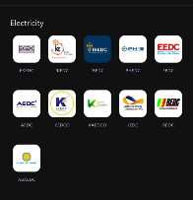
PAYVICE AVANTUS
Payvice brings the experience of agency banking to your fingertips with a revolutionary banking mobile app. This helps agents seamlessly manage their finances, transfer funds, view transactions and access a wide array of banking services anytime, anywhere.
Secure, user-friendly, and designed for your convenience, the app empowers you to take control of your financial business journey
Funds Transfer
Cash in/Out
VAS services (Airtime/Data, Bill Payments(All Discos)
Cable network subscriptions
Account Opening
Card issuance
Itex_ng

Slide 4
Creating Payvice Avantus Wallet.
Set Up Pay-Vice Wallet Details (I.E. Username and Wallet ID) • Open or use valid email address or Phone number • Go to Apple store or Google Playstore
CREATE ACCOUNT • STEP 1. Enter user details (Email address, Agent First and last Name). • STEP 2. Enter Password at least 8 character (must contain alphabet and numbers) & confirm password. • STEP 3. Enter transaction Pin 4 digits (numeric) & confirm Pin.
Verification code will be sent to your email, input the code on the column, account created successfully.
• A wallet ID is generated. i.e. 32432325 Note during wallet set-up on PAYVICE, password must consist of alphabets and numbers
Itex_ng

Slide 5
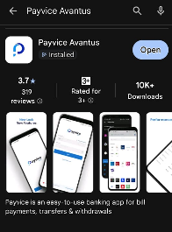
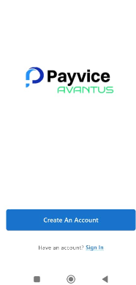
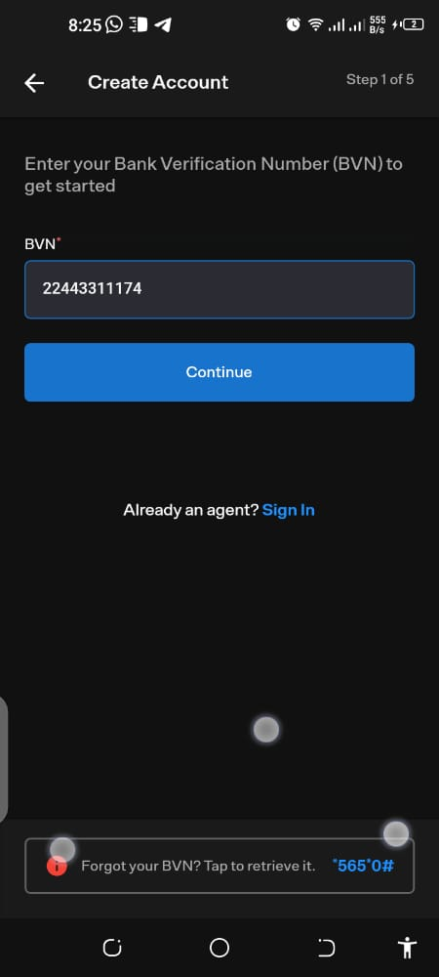
Creating Payvice Avantus Wallet.
Itex_ng

Slide 6
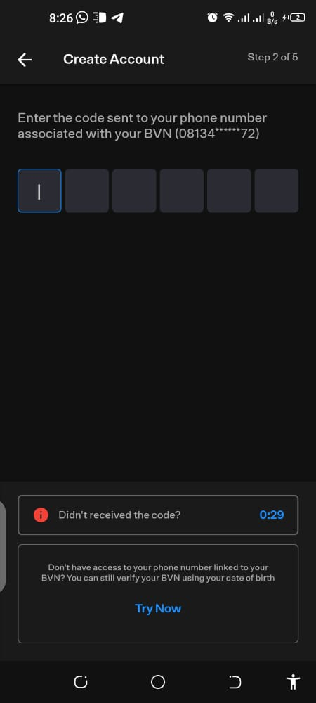
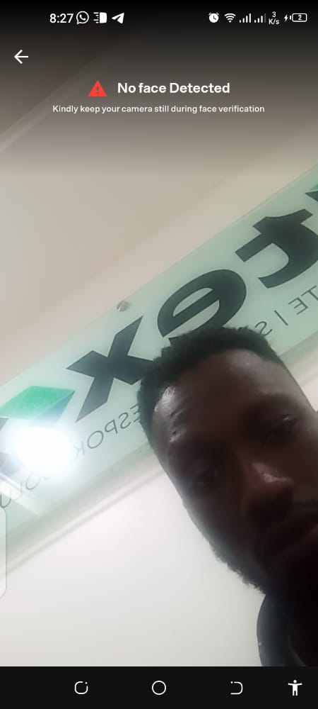

Creating Payvice Avantus Wallet.
Itex_ng

Slide 7
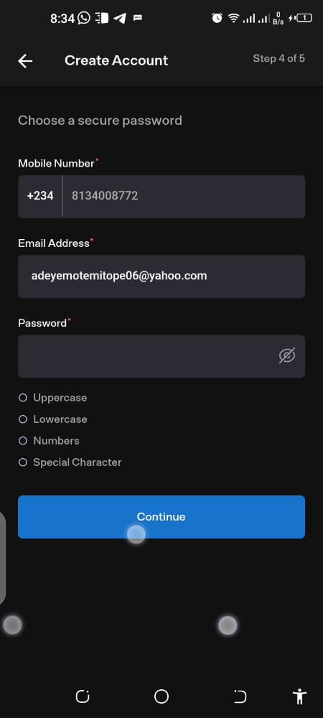
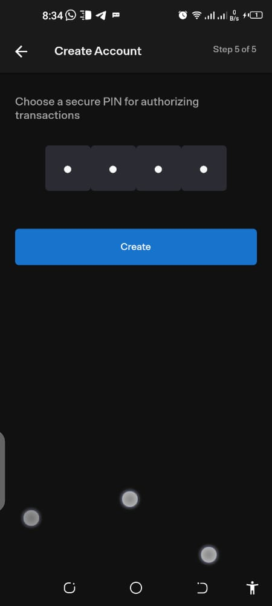
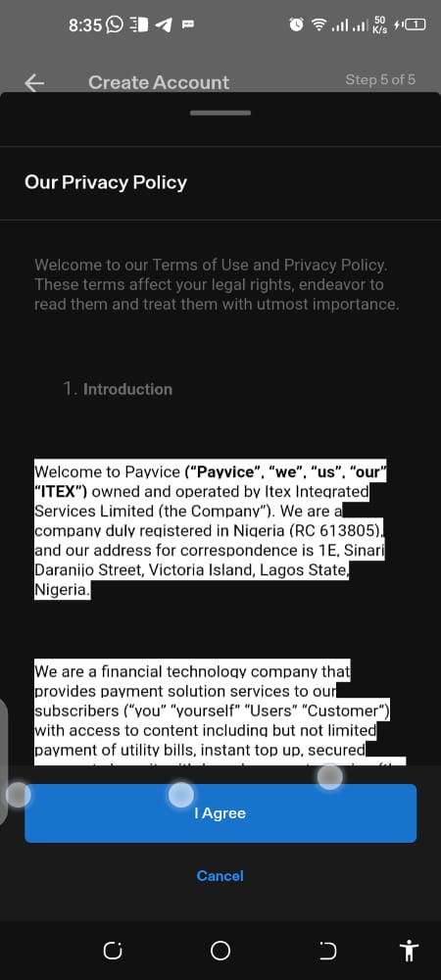
Creating Payvice Avantus Wallet.
Itex_ng

Slide 8
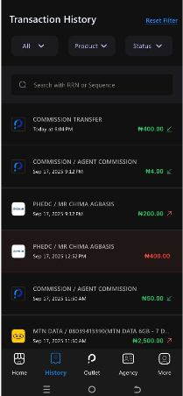
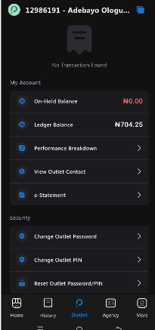
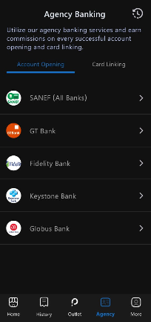
Creating Payvice Avantus Wallet.
Itex_ng

Slide 9
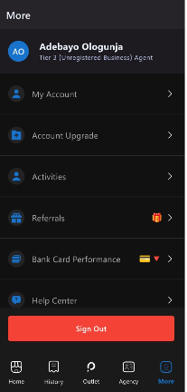
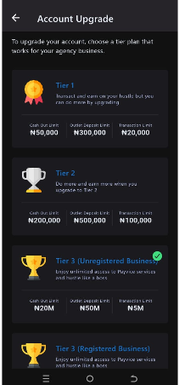
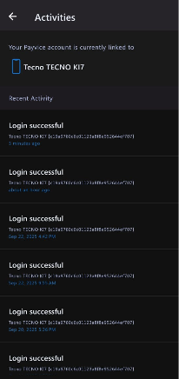
Creating Payvice Avantus Wallet.
Itex_ng

Slide 10
To Change Payvice Avantus Password and PIN.
Navigate to my Outlet on your Payvice mobile Application.
Step 1: Scroll Down to Security
Step 2: Select either
1 Change Outlet Password
2 Change Outlet Pin
3 Reset Outlet Password and Pin
Step 3: Enter your Date of birth to reset your outlet password/Pin
Itex_ng

Slide 11
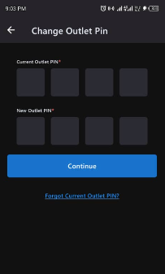
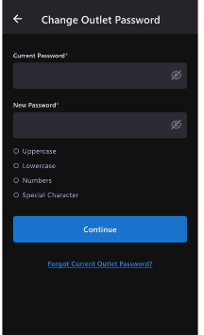
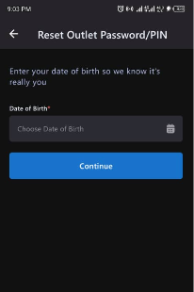
To Change Payvice Avantus Password and PIN.
Itex_ng

Slide 12
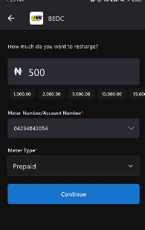
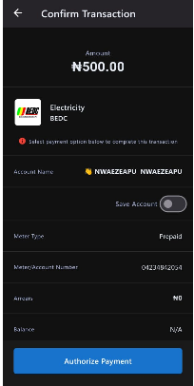
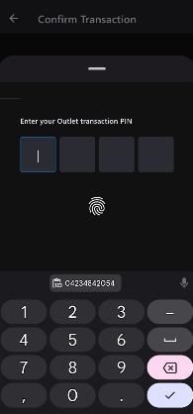
To Vend BEDC on Payvice Avantus.
Itex_ng

Slide 13
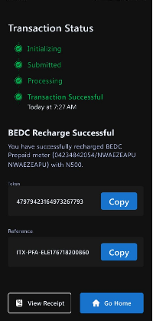
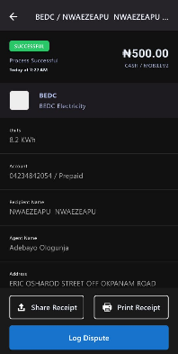
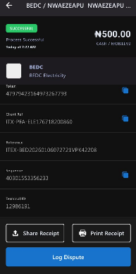
To Vend BEDC on Payvice Avantus.
Itex_ng

Slide 14

Itex_ng

Slide 15
1E Sinari Daranijo
Victoria Island
0700CALLITEX
(070022554839)
www.iisysgroup.com

